Slide 1
Jerk decomposition during upper limb movement
Neuromorph movement control

Slide 2
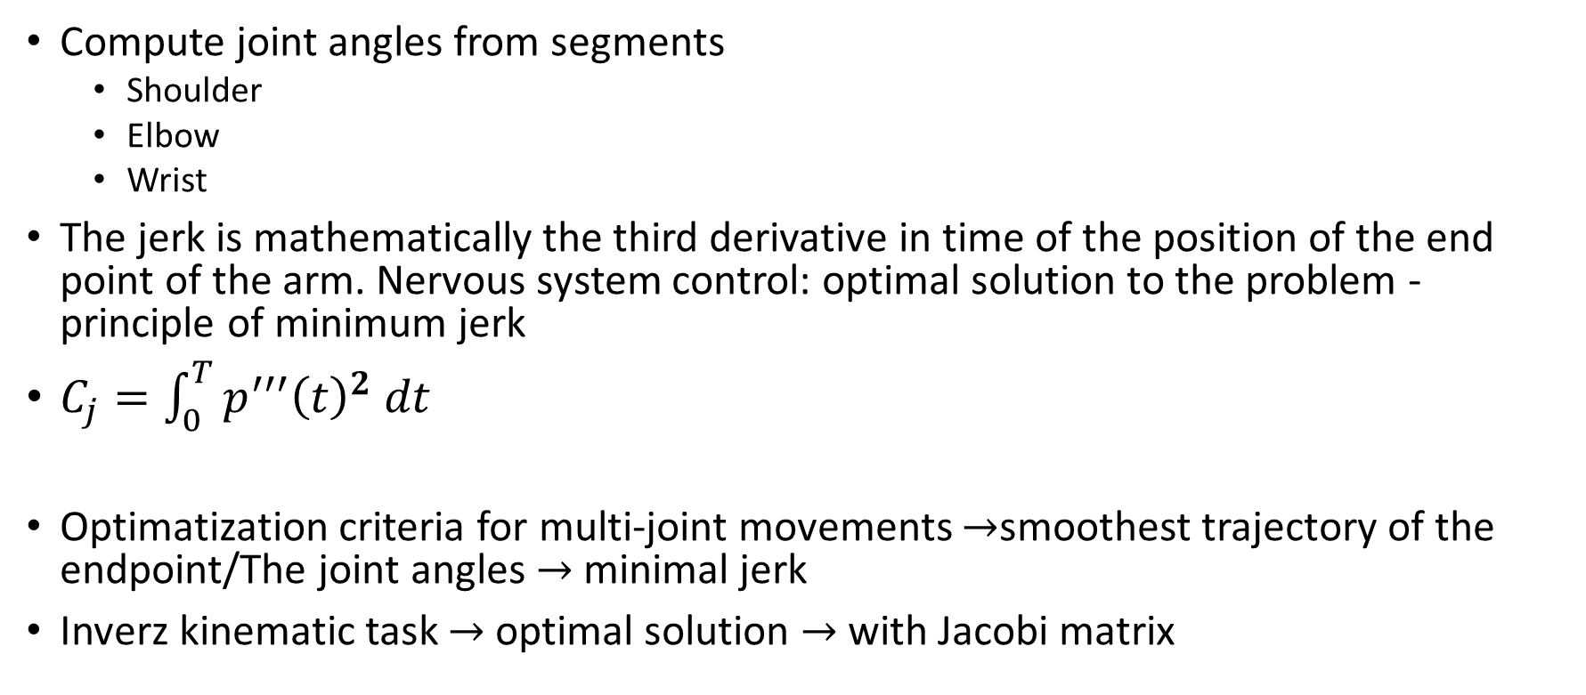
Joint angles
Compute joint angles from segments
Shoulder
Elbow
Wrist
The jerk is mathematically the third derivative in time of the position of the end point of the arm. Nervous system control: optimal solution to the problem - principle of minimum jerk
$C_{j}=\int_{0}^{T}{{p^{′′′}\left(t\right)}^{2} dt}$
Optimatization criteria for multi-joint movements $→$smoothest trajectory of the endpoint/The joint angles $→$ minimal jerk
Inverz kinematic task $→$ optimal solution $→$ with Jacobi matrix
Minimization of this quantity
Notes:
One of the most important controlling mechanism is the Minimum energy low

Slide 3
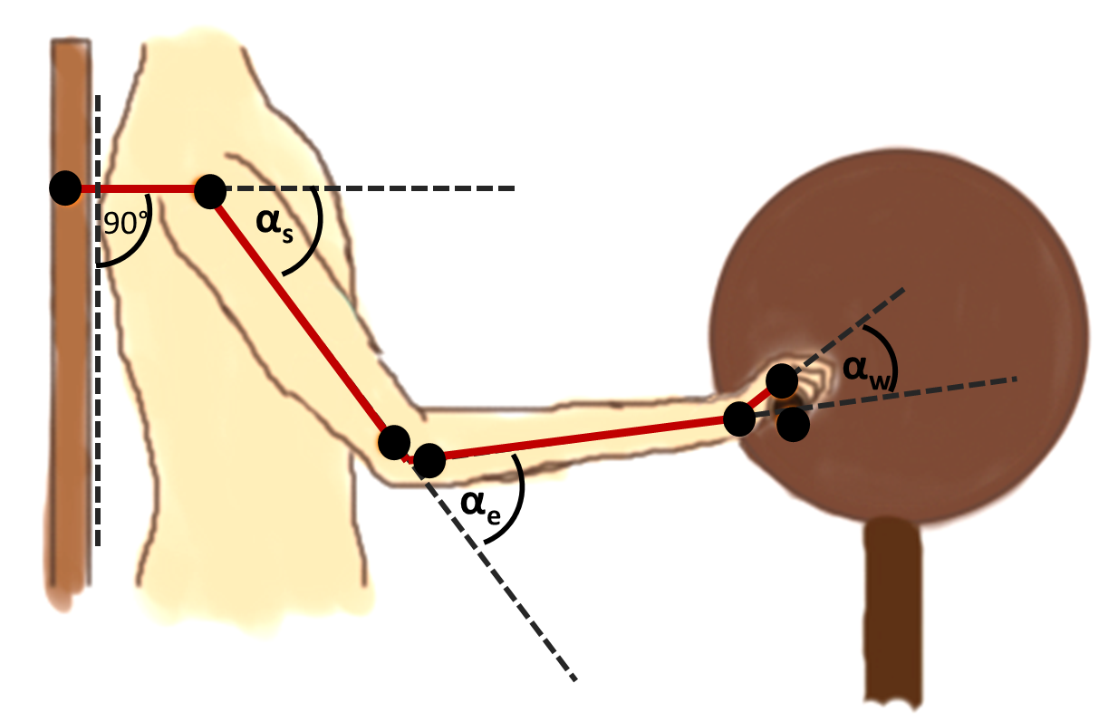
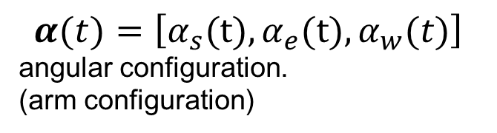
Relation of endpoint jerk and the Jacobi matrix
p(t) = [p_{x}(t), p_{y}(t)]
hand position
[p_{x,} p_{y}]
$$α(t)=\left[α_{s}\text{(}\text{t}\text{)},α_{e}\text{(}\text{t}\text{)},α_{w}(t)\right]$$
angular configuration.
(arm configuration)
$$=\left[{ −l_{1}s\left(α_{s}\right.)−l_{2}s\left(α_{s}+α_{e}\right.)−l_{3}s\left(α_{s}+α_{e}+α_{w}\right.); −l_{2}s\left(α_{s}+α_{e}\right.)−l_{3}s\left(α_{s}+α_{e}+α_{w}\right.); −l_{3}s\left(α_{s}+α_{e}+α_{w}\right.) \atop \left.l_{1}c\left(α_{s}\right)+l_{2}c\left(α_{s}+α_{e}\right.)+l_{3}c\left(α_{s}+α_{e}+α_{w}\right.) ; l_{2}c{(α_{s}+α_{e}})+l_{3}c\left(α_{s}+α_{e}+α_{w}\right.); l_{3}c\left(α_{s}+α_{e}+α_{w}\right.\right)}\right]$$
J
$p^{′′′}\left(t\right)=J^{′′}\left(t\right)α^{′}\left(t\right)+2J^{′}\left(t\right)α^{′′}\left(t\right)+J\left(t\right)α^{′′′}\left(t\right).$
s=sin; c=cos
Notes:
Joint angles
We can calculate the actual endpoint position from the joint angles and the length of the segments with the Jacobi matrix

Slide 4
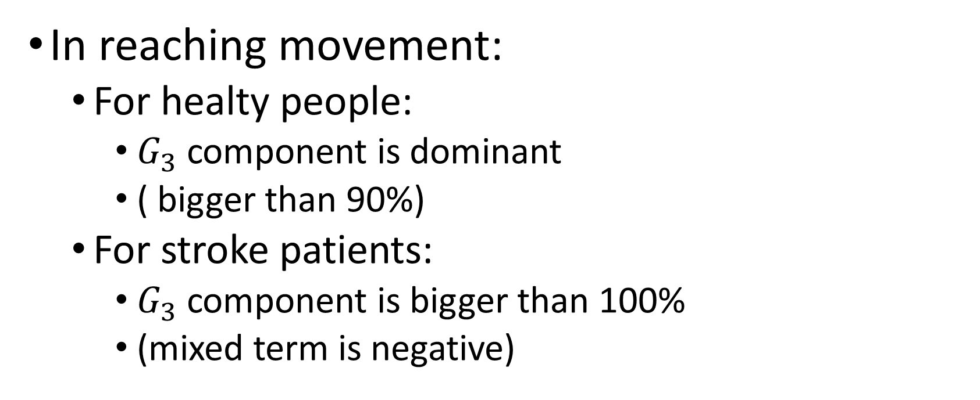
Jerk as a diagnostical indicator
In reaching movement:
For healty people:
$G_{3}$ component is dominant
( bigger than 90%)
For stroke patients:
$G_{3}$ component is bigger than 100%
(mixed term is negative)

Slide 5
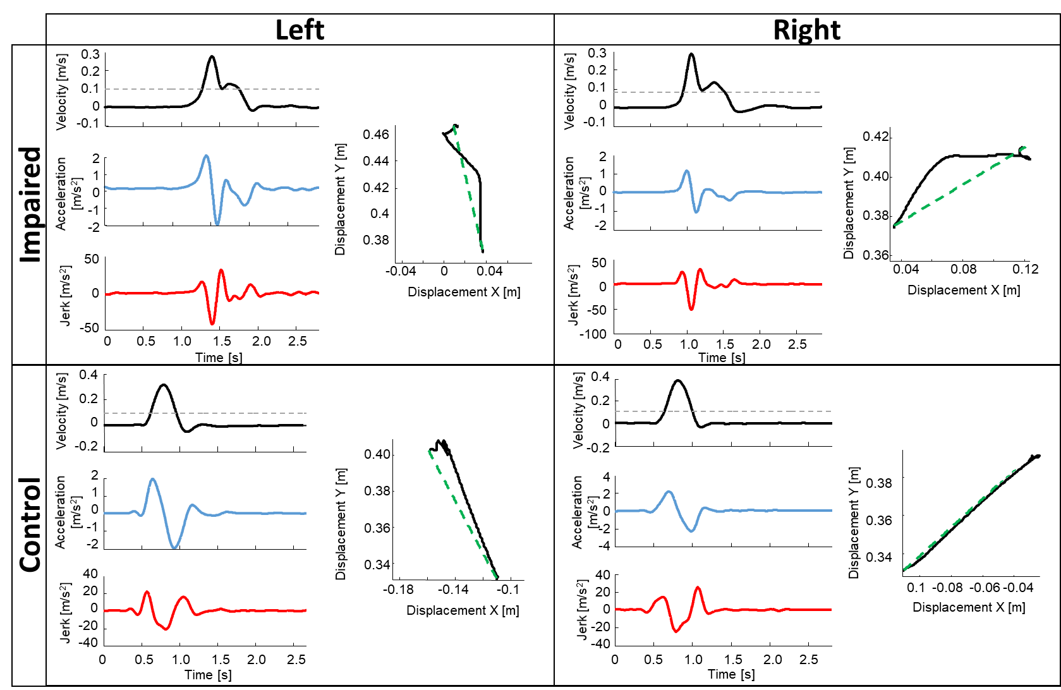
Reaching movement
Laczko J, Scheidt RA, Simo LS, Piovesan D: Inter-joint coordination deficits revealed in the decomposition of endpoint jerk during goal-directed arm movement after stroke., IEEE TRANSACTIONS ON NEURAL SYSTEMS AND REHABILITATION ENGINEERING 25: (7) pp. 798-810

Slide 6
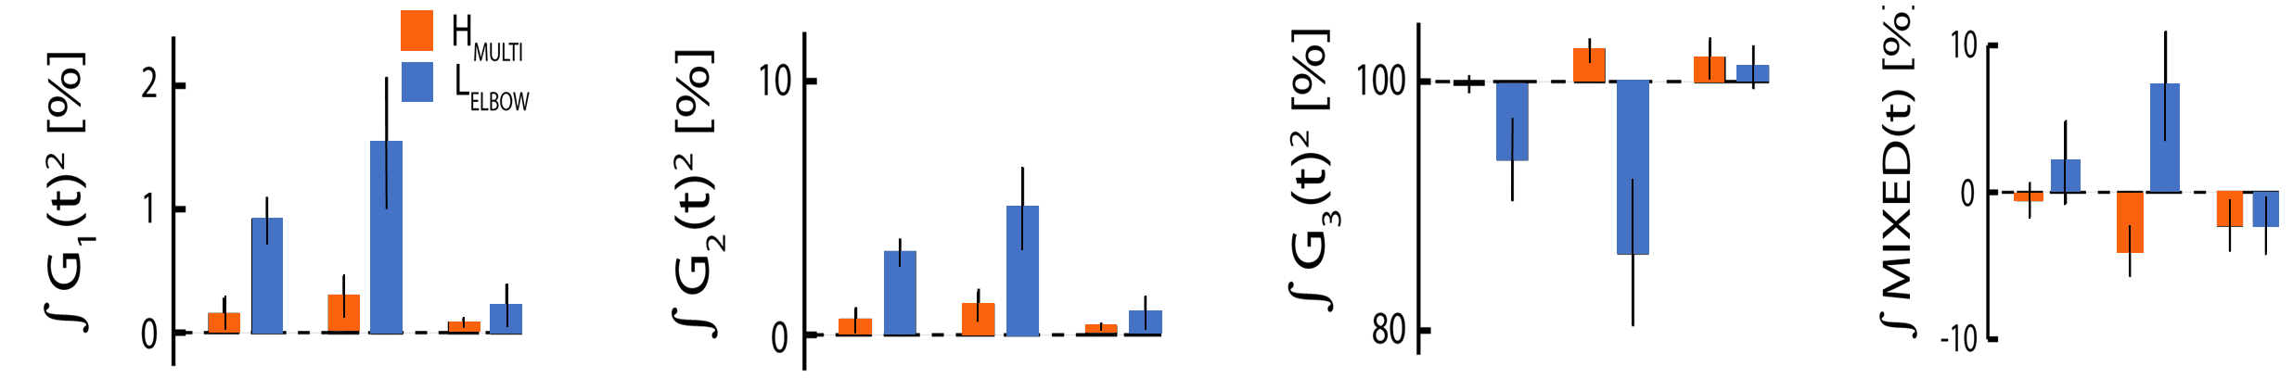
Reaching movement
Laczko J, Scheidt RA, Simo LS, Piovesan D: Inter-joint coordination deficits revealed in the decomposition of endpoint jerk during goal-directed arm movement after stroke., IEEE TRANSACTIONS ON NEURAL SYSTEMS AND REHABILITATION ENGINEERING 25: (7) pp. 798-810

Slide 7
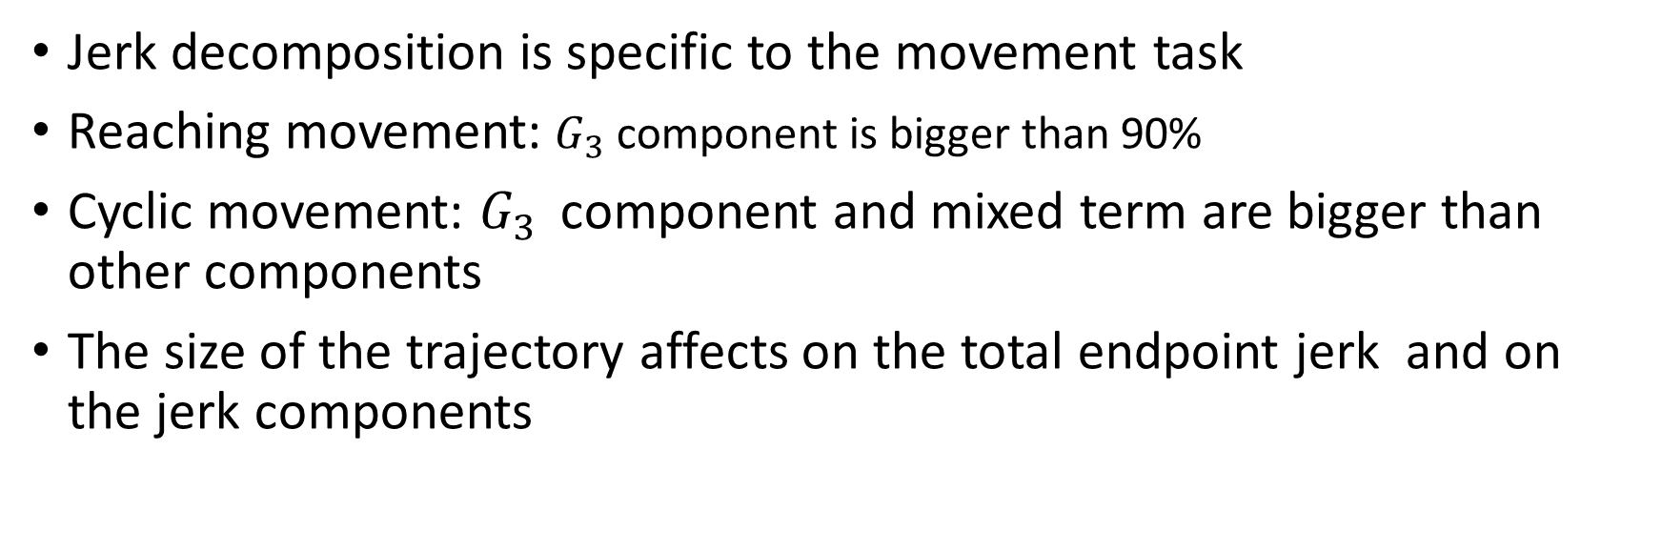
Jerk as an essential component of the movement task
Jerk decomposition is specific to the movement task
Reaching movement: $G_{3}$ component is bigger than 90%
Cyclic movement: $G_{3 }$ component and mixed term are bigger than other components
The size of the trajectory affects on the total endpoint jerk and on the jerk components

Slide 8
Jerk as an essential component of the movement task
∫G1² ∫G2² ∫G3² ∫ mixed
∫G1² ∫G2² ∫G3² ∫ mixed

Slide 9
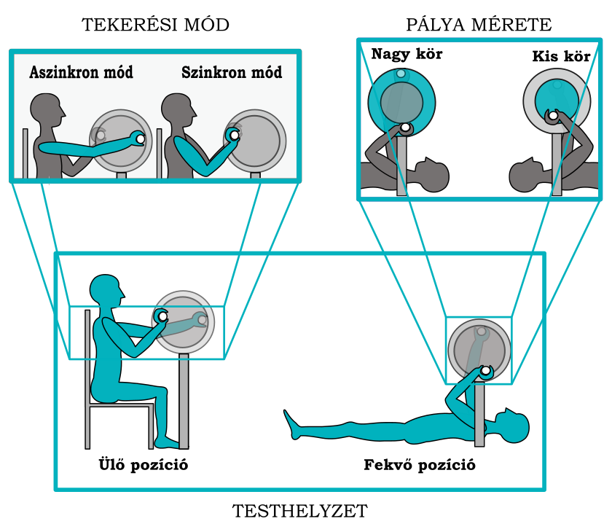
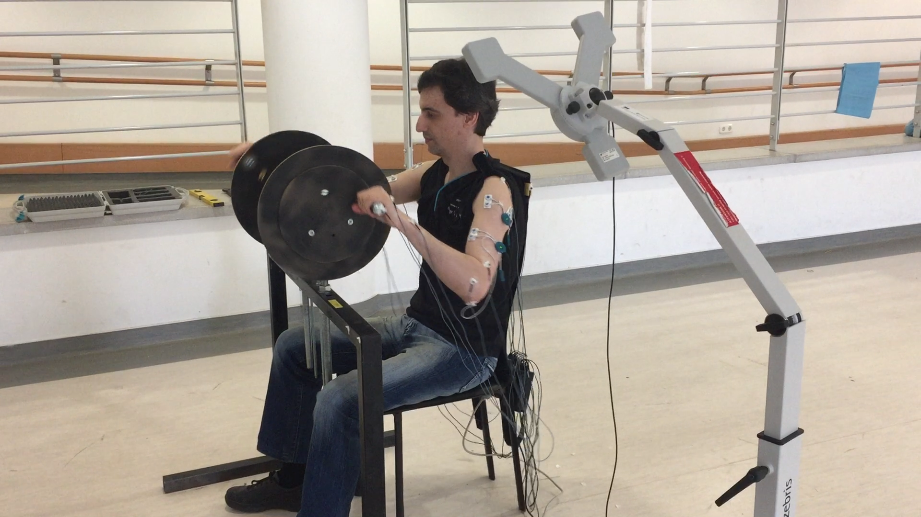
Experimental setup
two handles (left and right) are unconnected
Twelve able bodied persons (6 male, 6 female, 26.9 +/-6.4 years)
Conditions:Right or left, Different radius (little and big) => different trajectory, Sitting and supine position
60rpm, 30 cycles

Slide 10
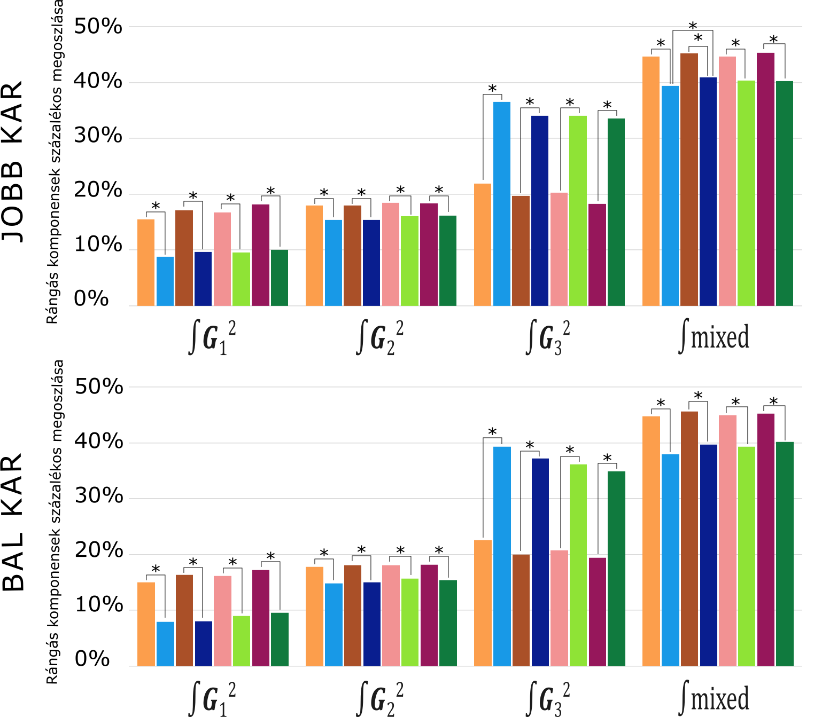
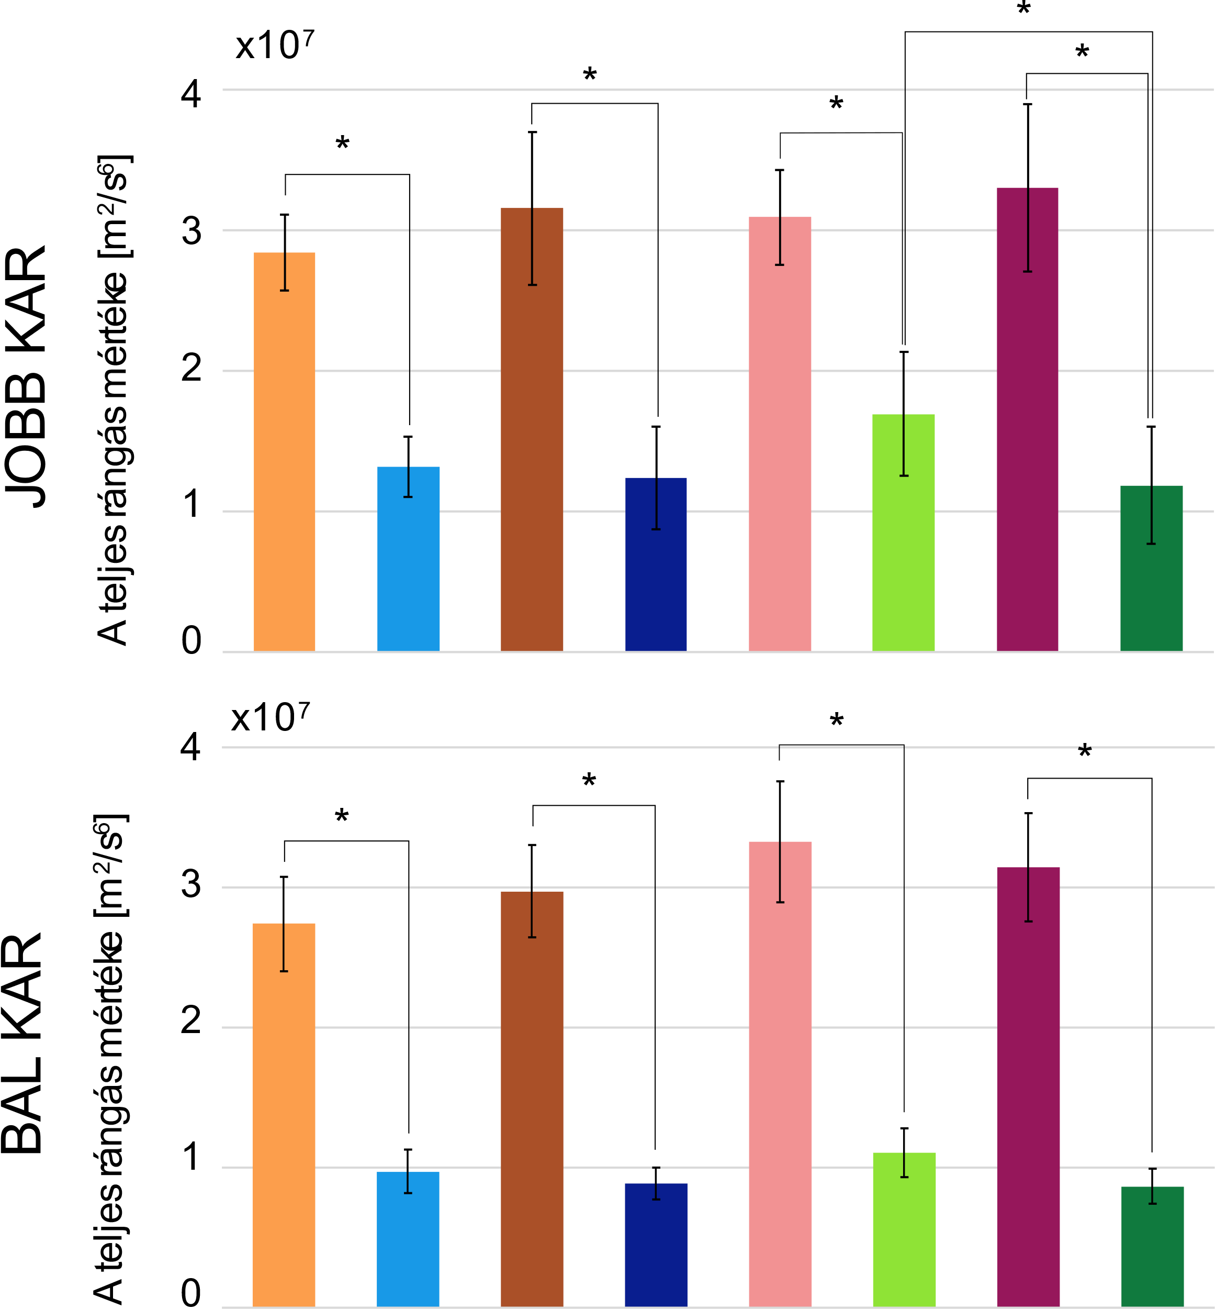
Jerk components in arm cranking

Slide 11

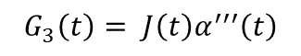
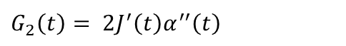
Cartesian coordinates of the components of the endpoint jerk
$$=\left[{ −l_{1}s\left(α_{s}\right.)−l_{2}s\left(α_{s}+α_{e}\right.)−l_{3}s\left(α_{s}+α_{e}+α_{w}\right.); −l_{2}s\left(α_{s}+α_{e}\right.)−l_{3}s\left(α_{s}+α_{e}+α_{w}\right.); −l_{3}s\left(α_{s}+α_{e}+α_{w}\right.) \atop \left.l_{1}c\left(α_{s}\right)+l_{2}c\left(α_{s}+α_{e}\right.)+l_{3}c\left(α_{s}+α_{e}+α_{w}\right.) ; l_{2}c{(α_{s}+α_{e}})+l_{3}c\left(α_{s}+α_{e}+α_{w}\right.); l_{3}c\left(α_{s}+α_{e}+α_{w}\right.\right)}\right]$$
X coordinates
Y coordinates
J
$$G_{1}\left(t\right)= J^{′′}\left(t\right)α^{′}\left(t\right)$$
(m/s³)
(m/s³)
$G_{2}\left(t\right)= 2J^{′}\left(t\right)α^{′′}\left(t\right)$
$$G_{3}\left(t\right)= J\left(t\right)α^{′′′}\left(t\right)$$
(m/s³)
time (s)
time (s)

Slide 12
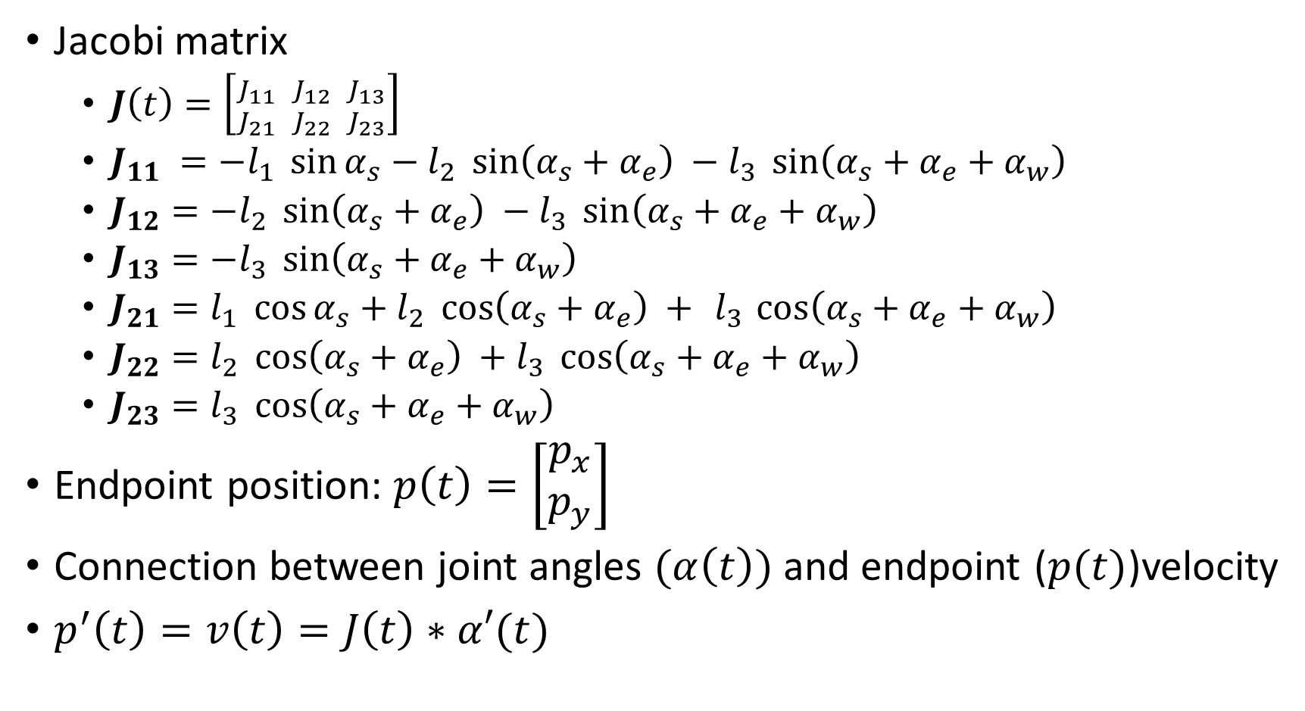
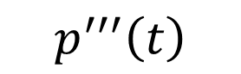
Connection between joint angles and endpoint velocity
Jacobi matrix
$J\left(t\right)=\left[{J_{11} \atop J_{21}} {J_{12} \atop J_{22}} {J_{13} \atop J_{23}}\right]$
$J_{11} =−l_{1} \sin{α_{s}}−l_{2} \sin\left(α_{s}+α_{e}\right) −l_{3} \sin\left(α_{s}+α_{e}+α_{w}\right)$
$J_{12}=−l_{2} \sin\left(α_{s}+α_{e}\right) −l_{3} \sin\left(α_{s}+α_{e}+α_{w}\right)$
$J_{13}=−l_{3} \sin\left(α_{s}+α_{e}+α_{w}\right)$
$J_{21}=l_{1} \cos{α_{s}}+l_{2} \cos\left(α_{s}+α_{e}\right) +{ l}_{3} \cos\left(α_{s}+α_{e}+α_{w}\right)$
$J_{22}=l_{2} \cos\left(α_{s}+α_{e}\right) +l_{3} \cos\left(α_{s}+α_{e}+α_{w}\right)$
$J_{23}=l_{3} \cos\left(α_{s}+α_{e}+α_{w}\right)$
Endpoint position: $p\left(t\right)=\left[\begin{matrix}p_{x} \\ p_{y}\end{matrix}\right]$
Connection between joint angles $(α\left(t\right))$ and endpoint ($p(t)$)velocity
$p^{′}\left(t\right)=v\left(t\right)=J\left(t\right)∗α′(t)$
$$p^{′′′}\left(t\right)$$
Notes:
Composite function

Slide 13



Partitioning of Endpoint Jerk
The endpoint jerk is the sum of components related to
joint angular velocities,
- angular accelerations and
- angular jerks
and to arm configuration and its derivatives.
Which component is the most dominant?
$p′ (t)=J\left(t\right) α′(t)$ ,
$p^{′′}\left(t\right)=J^{′}\left(t\right)α^{′}\left(t\right)+J\left(t\right)α^{′′}\left(t\right)$.
$p^{′′′}\left(t\right)=J^{′′}\left(t\right)α^{′}\left(t\right)+2J^{′}\left(t\right)α^{′′}\left(t\right)+J\left(t\right)α^{′′′}\left(t\right).$
$G_{1}\left(t\right)= J^{′′}\left(t\right)α^{′}\left(t\right);$ $G_{2}\left(t\right)= 2J^{′}\left(t\right)α^{′′}\left(t\right);$
$G_{3}\left(t\right)= J\left(t\right)α^{′′′}\left(t\right).$
Depends
on angular jerk
Independent of the joint angular jerk
Notes:
Composite function
Multiplation function
Rules of derivation

Slide 14
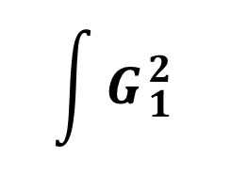
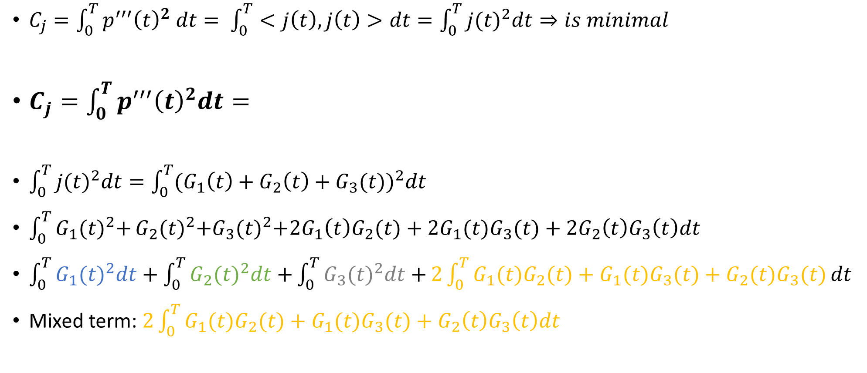
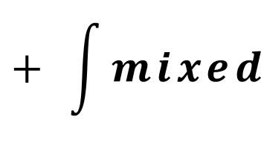
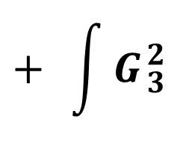
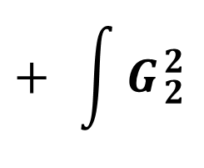
Minimal jerk
$C_{j}=\int_{0}^{T}{{p^{′′′}\left(t\right)}^{2} dt}= \int_{0}^{T}{<j\left(t\right),j\left(t\right)>dt=\int_{0}^{T}{{j(t)}^{2}dt⇒is minimal}}$
$C_{j}=\int_{0}^{T}{{p^{′′′}\left(t\right)}^{2}dt}=$
$\int_{0}^{T}{{j(t)}^{2}dt=\int_{0}^{T}{{(G_{1}\left(t\right)+G_{2}\left(t\right)+G_{3}(t))}^{2}dt}}$
${\int_{0}^{T}{G_{1}{(t)}^{2}+}G}_{2}{(t)}^{2}+G_{3}{(t)}^{2}+{2G}_{1}\left(t\right)G_{2}(t)+{2G}_{1}(t)G_{3}(t)+{2G}_{2}\left(t\right)G_{3}\left(t\right)dt$
$\int_{0}^{T}{G_{1}{(t)}^{2}dt+\int_{0}^{T}{G_{2}{(t)}^{2}dt+}\int_{0}^{T}{G_{3}{(t)}^{2}dt+}2\int_{0}^{T}{G_{1}(t)G_{2}(t)+G_{1}(t)G_{3}(t)+G_{2}(t)G_{3}(t)}}dt$
Mixed term: $2\int_{0}^{T}{G_{1}(t)G_{2}(t)+G_{1}(t)G_{3}(t)+G_{2}\left(t\right)G_{3}\left(t\right)dt}$
$$\int{G_{1}^{2}}$$
$$+ \int{G_{2}^{2}}$$
$$+ \int{G_{3}^{2}}$$
$$+ \int{mixed}$$

Slide 15
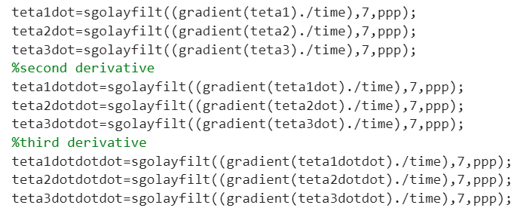
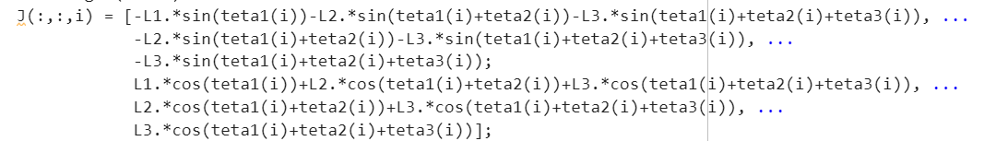
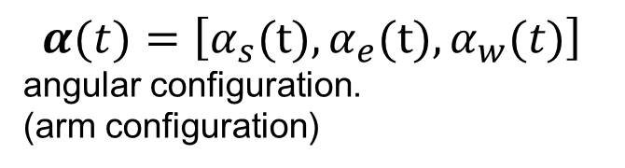
$$α(t)=\left[α_{s}\text{(}\text{t}\text{)},α_{e}\text{(}\text{t}\text{)},α_{w}(t)\right]$$
angular configuration.
(arm configuration)
$$=\left[{ −l_{1}s\left(α_{s}\right.)−l_{2}s\left(α_{s}+α_{e}\right.)−l_{3}s\left(α_{s}+α_{e}+α_{w}\right.); −l_{2}s\left(α_{s}+α_{e}\right.)−l_{3}s\left(α_{s}+α_{e}+α_{w}\right.); −l_{3}s\left(α_{s}+α_{e}+α_{w}\right.) \atop \left.l_{1}c\left(α_{s}\right)+l_{2}c\left(α_{s}+α_{e}\right.)+l_{3}c\left(α_{s}+α_{e}+α_{w}\right.) ; l_{2}c{(α_{s}+α_{e}})+l_{3}c\left(α_{s}+α_{e}+α_{w}\right.); l_{3}c\left(α_{s}+α_{e}+α_{w}\right.\right)}\right]$$
J

Slide 16
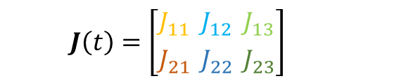
$$J\left(t\right)=\left[{J_{11} \atop J_{21}} {J_{12} \atop J_{22}} {J_{13} \atop J_{23}}\right]$$
%Jacobian first derivative
DJdt(:,:,i)=[-L1.*cos(teta1(i)).*teta1dot(i)-L2.*cos(teta1(i)+teta2(i)).*(teta1dot(i)+teta2dot(i))-L3.*cos(teta1(i)+teta2(i)+teta3(i)).*(teta1dot(i)+teta2dot(i)+teta3dot(i)), ...
-L2.*cos(teta1(i)+teta2(i)).*(teta1dot(i)+teta2dot(i))-L3.*cos(teta1(i)+teta2(i)+teta3(i)).*(teta1dot(i)+teta2dot(i)+teta3dot(i)), ...
-L3.*cos(teta1(i)+teta2(i)+teta3(i)).*(teta1dot(i)+teta2dot(i)+teta3dot(i));
-L1.*sin(teta1(i)).*teta1dot(i)-L2.*sin(teta1(i)+teta2(i)).*(teta1dot(i)+teta2dot(i))-L3.*sin(teta1(i)+teta2(i)+teta3(i)).*(teta1dot(i)+teta2dot(i)+teta3dot(i)), ...
-L2.*sin(teta1(i)+teta2(i)).*(teta1dot(i)+teta2dot(i))-L3.*sin(teta1(i)+teta2(i)+teta3(i)).*(teta1dot(i)+teta2dot(i)+teta3dot(i)), ...
-L3.*sin(teta1(i)+teta2(i)+teta3(i)).*(teta1dot(i)+teta2dot(i)+teta3dot(i))];
%Jacobian second derivative
D2Jdt2(:,:,i)= [-L1.*cos(teta1(i)).*teta1dotdot(i)-L2.*cos(teta1(i)+teta2(i)).*(teta1dotdot(i)+teta2dotdot(i))-L3.*cos(teta1(i)+teta2(i)+teta3(i)).*(teta1dotdot(i)+teta2dotdot(i)+teta3dotdot(i))+L1.*sin(teta1(i)).*teta1dot(i).^2+L2.*sin(teta1(i)+teta2(i)).*(teta1dot(i)+teta2dot(i)).^2+L3.*sin(teta1(i)+teta2(i)+teta3(i)).*(teta1dot(i)+teta2dot(i)+teta3dot(i)).^2,...
-L2.*cos(teta1(i)+teta2(i)).*(teta1dotdot(i)+teta2dotdot(i))-L3.*cos(teta1(i)+teta2(i)+teta3(i)).*(teta1dotdot(i)+teta2dotdot(i)+teta3dotdot(i))+L2.*sin(teta1(i)+teta2(i)).*(teta1dot(i)+teta2dot(i)).^2+L3.*sin(teta1(i)+teta2(i)+teta3(i)).*(teta1dot(i)+teta2dot(i)+teta3dot(i)).^2, ...
-L3.*cos(teta1(i)+teta2(i)+teta3(i)).*(teta1dotdot(i)+teta2dotdot(i)+teta3dotdot(i))+L3.*sin(teta1(i)+teta2(i)+teta3(i)).* (teta1dot(i)+teta2dot(i)+teta3dot(i)).^2;
-L1.*sin(teta1(i)).*teta1dotdot(i)-L2.*sin(teta1(i)+teta2(i)).*(teta1dotdot(i)+teta2dotdot(i))-L3.*sin(teta1(i)+teta2(i)+teta3(i)).*(teta1dotdot(i)+teta2dotdot(i)+teta3dotdot(i))-L1.*cos(teta1(i)).*teta1dot(i).^2-L2.*cos(teta1(i)+teta2(i)).*(teta1dot(i)+teta2dot(i)).^2-L3.*cos(teta1(i)+teta2(i)+teta3(i)).*(teta1dot(i)+teta2dot(i)+teta3dot(i)).^2,...
-L2.*sin(teta1(i)+teta2(i)).*(teta1dotdot(i)+teta2dotdot(i))-L3.*sin(teta1(i)+teta2(i)+teta3(i)).*(teta1dotdot(i)+teta2dotdot(i)+teta3dotdot(i))-L2.*cos(teta1(i)+teta2(i)).*(teta1dot(i)+teta2dot(i)).^2-L3.*cos(teta1(i)+teta2(i)+teta3(i)).*(teta1dot(i)+teta2dot(i)+teta3dot(i)).^2, ...
-L3.*sin(teta1(i)+teta2(i)+teta3(i)).*(teta1dotdot(i)+teta2dotdot(i)+teta3dotdot(i))-L3.*cos(teta1(i)+teta2(i)+teta3(i)).*(teta1dot(i)+teta2dot(i)+teta3dot(i)).^2];

Slide 17
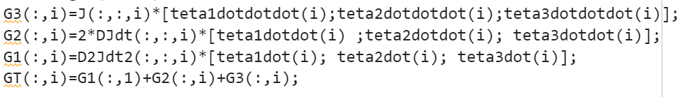
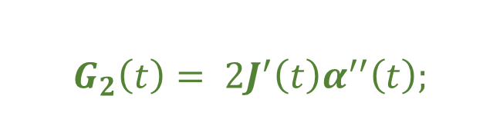
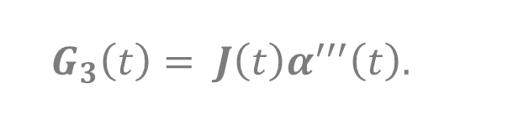
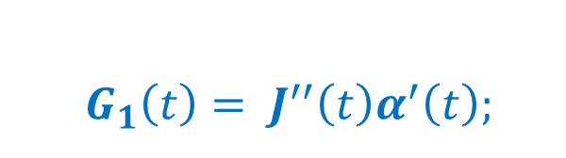
$p^{′′′}\left(t\right)=J^{′′}\left(t\right)α^{′}\left(t\right)+2J^{′}\left(t\right)α^{′′}\left(t\right)+J\left(t\right)α^{′′′}\left(t\right).$
$G_{1}\left(t\right)= J^{′′}\left(t\right)α^{′}\left(t\right);$
$$G_{2}\left(t\right)= 2J^{′}\left(t\right)α^{′′}\left(t\right);$$
$G_{3}\left(t\right)= J\left(t\right)α^{′′′}\left(t\right).$

Slide 18
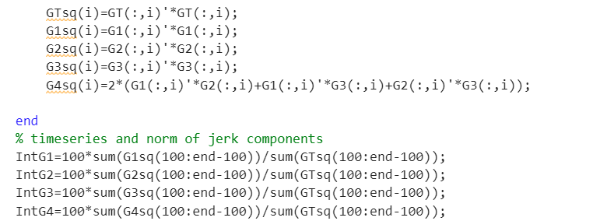
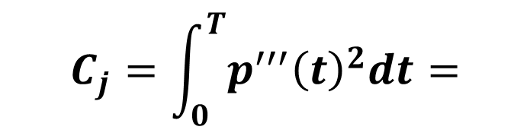
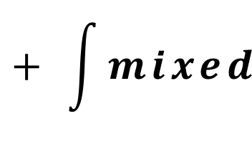
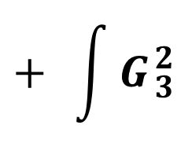
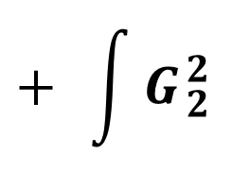
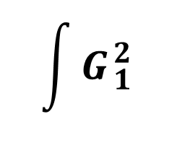
$$C_{j}=\int_{0}^{T}{{p^{′′′}\left(t\right)}^{2}dt}=$$
$$\int{G_{1}^{2}}$$
$$+ \int{G_{2}^{2}}$$
$$+ \int{G_{3}^{2}}$$
$$+ \int{mixed}$$

